Slide 1
MANUFACTURING
Is YOUR future made in
Manufacturing?

Slide 3
What is Manufacturing?
The process of making products, converting parts, components, and raw materials into finished products through the use of labor, machines, tools, and chemical or biological processes or formulation. The finished goods meet customers’ specifications or expectations.
In other words….Manufacturing is MAKING STUFF!

Slide 4
Manufacturing is all around us

Slide 5
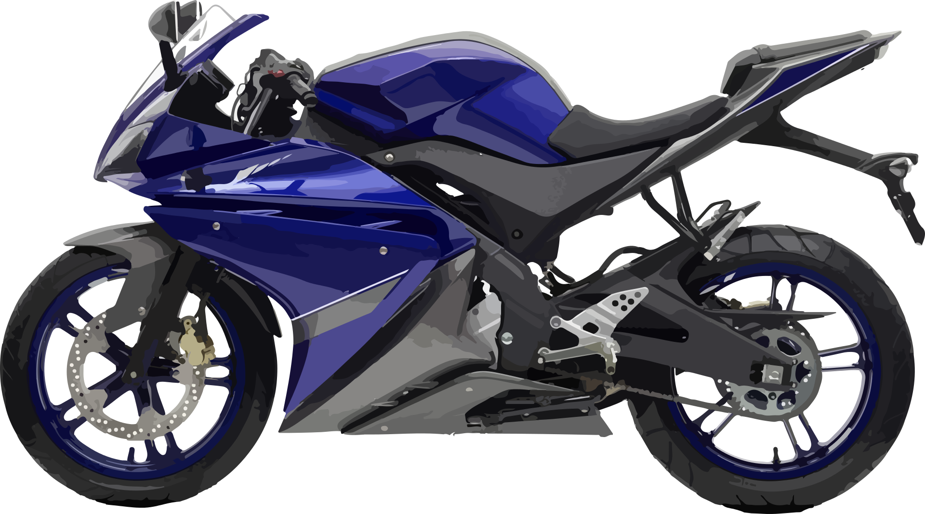
From Motorcycles
to Medicine
From Popcorn
To Pet Food
From Motorcycles
to Medicine

Slide 6
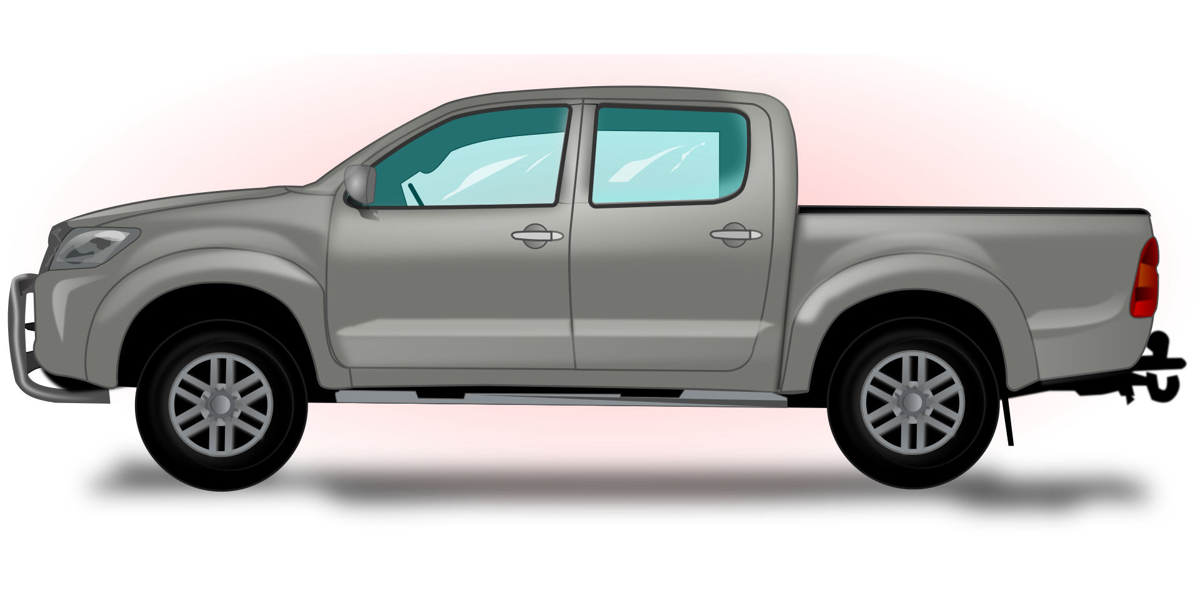
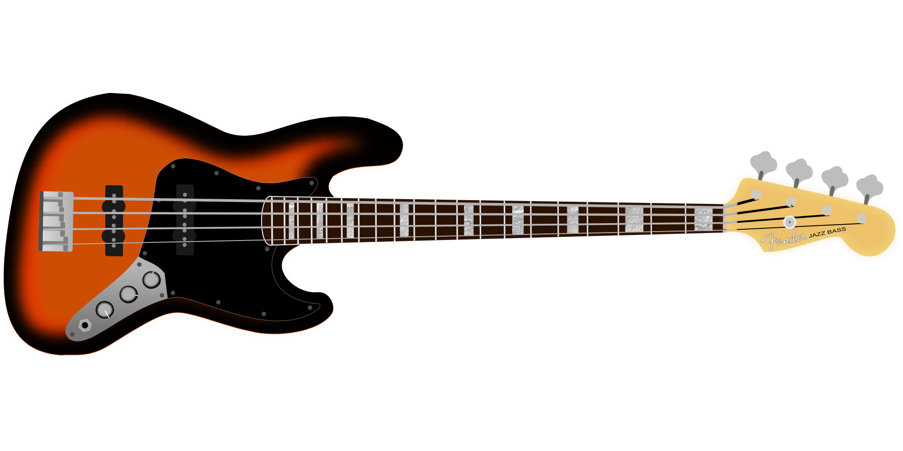
From Trucks
to Toys
From Games
To Guitars

Slide 7
It all starts with an IDEA…

Slide 8
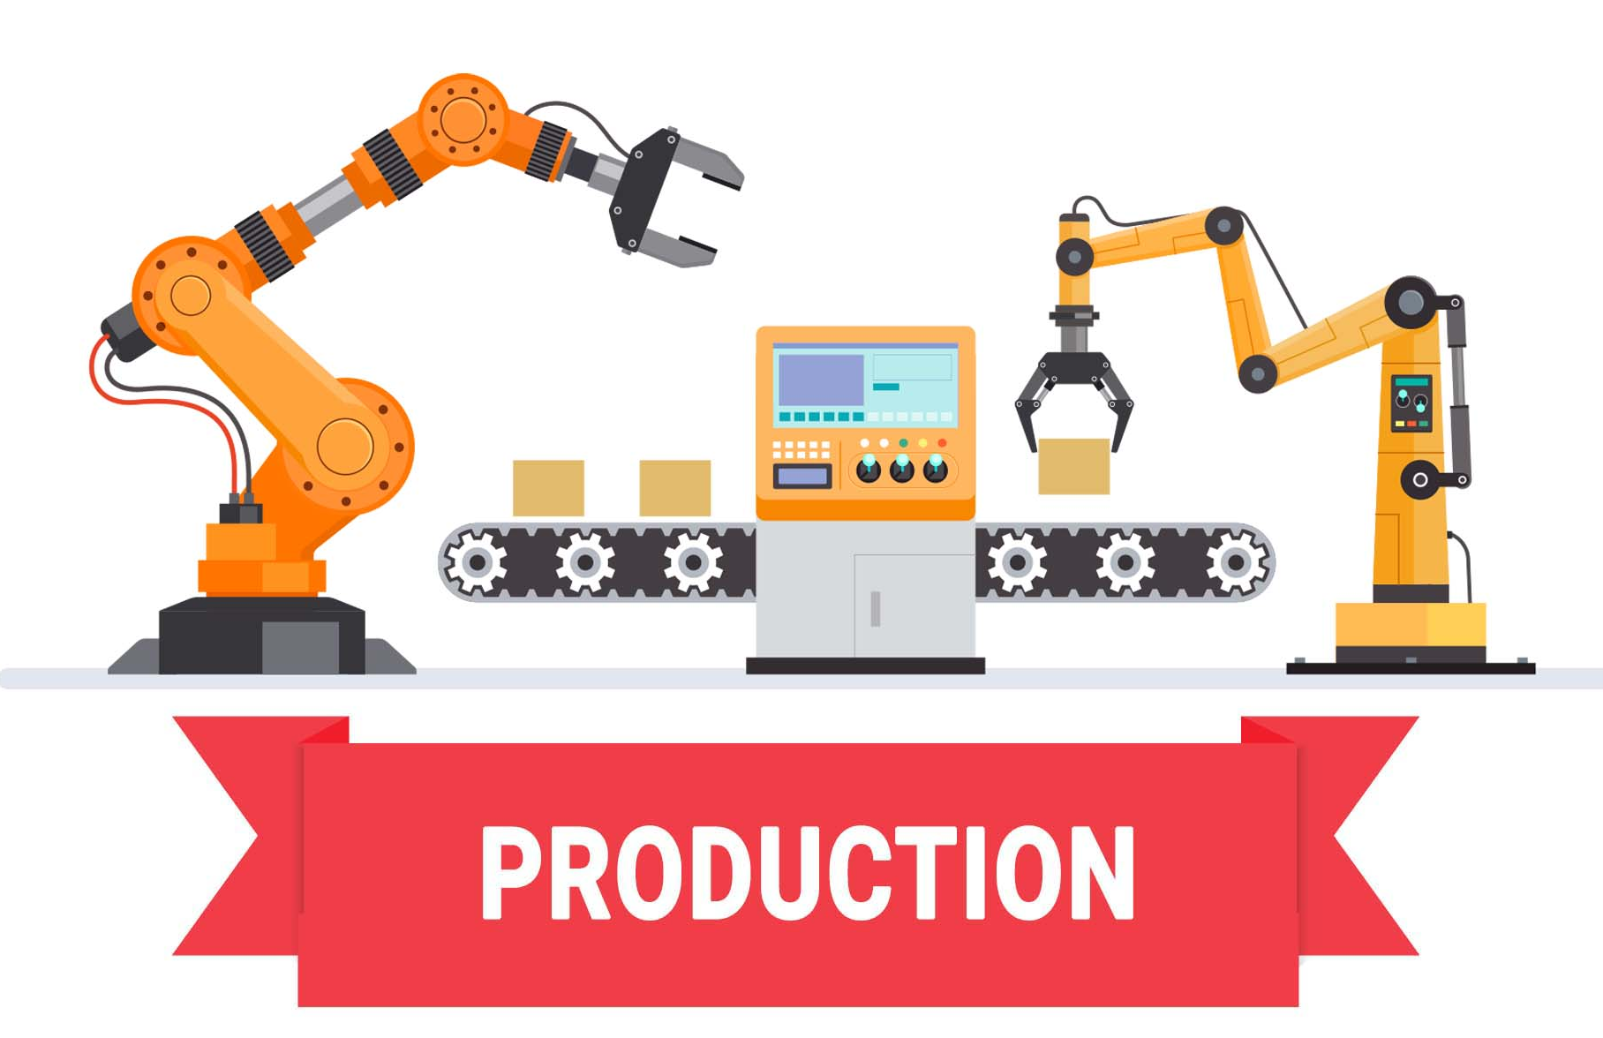
Then on to Manufacturing…

Slide 9
RESEARCH & DESIGN
CAREER PATHS:
Engineering Research
Science Design
ESSENTIAL SKILLS include math, attention to detail, problem solving, creativity, time management and leadership skills.
Most aspiring engineers will need at least a bachelor’s degree from an engineering school or university, and the best-paid engineers usually have a master’s degree or Ph.D. in their field.

Slide 10
MARKETING & SALES
Additional careers in manufacturing:
Human Resources
Information Technology
Administrative Support
Accounting
Purchasing
Management
CAREER PATHS
Marketing Customer Service
Sales Data Control
ESSENTIAL SKILLS include customer service, sales, negotiating and influencing, analysis and decision-making, management, creativity, time management and leadership skills.
Areas of knowledge/interests: people, the business environment, product knowledge and financial awareness

Slide 11
PRODUCTION
CAREER PATHS:
HS Diploma 1 -2 Year Degree/Training 4 Year+ Degree
General Production Machinists Engineering
Welding Maintenance Management
Machine Operations Specialty Welding
Tool & Die
Drafting
Engineering Techs
Production Team Leaders
ESSENTIAL SKILLS include critical thinking, ability to work on a diverse team, STEM skills, flexibility, PROBLEM SOLVING, technology/computer skills, programming skills for robotics/automation, working with tools and technology, management, creativity, time management and leadership skills.

Slide 12
DISTRIBUTION
ESSENTIAL SKILLS include SAFETY, can stay motivated and alert, self-motivation, organization, good navigation skills, creativity, time management and leadership skills.
The top truck driver skills go beyond just being able to steer an 18-wheeler.
CAREER PATHS
Logistics Drivers
Loaders

Slide 13
What do you like to do. What are you good at?
I’m good
with numbers
I LOVE
Science
I like to work with computers
I like to work with my hands

Slide 14
Questions?

